Slide 1

Water Quality and Urban Stormwater Pollution Basics
Video 1
Stormwater 101 Training
Prepared by INCOG for
Green Country Stormwater Alliance (GCSA)
June 2020

Slide 2
Purpose of This Video Series
New GCSA Member staff
New municipal management
New council members & commissioners
Refresher for experienced staff
Help with training future staff

Slide 3
Federal Level
CWA - Congress passes 1972 Clean Water Act
EPA – adopts water quality stormwater rules
States – EPA delegates authority to states

Slide 4
Oklahoma DEQ Permitting Authority
WWTPs – municipal, industrial
Stormwater – Phase I and II
Tribes – EPA authority
Oil & Gas – Corp. Commission

Slide 5
Oklahoma Water Quality Standards
OWRB – Lead agency over WQS
Three Components:
Designation of Beneficial Uses
Narrative & numerical criteria
Anti-degradation

Slide 6

WQS Beneficial Uses
Public and Private Water Supply
Emergency Water Supply
Fish and Wildlife Propagation
Habitat Limited Aquatic Community
Warm Water Aquatic Community
Cool Water Aquatic Community
Trout Fishery (put and take)
Recreation (Primary and Secondary Body Contact)
Agriculture (Livestock and Irrigation)
Aesthetics
Navigation
Fish Consumption (human, water and fish)

Slide 7
Biocriteria WQS
Addresses Stream Organisms:
Macroinvertebrates
Fish
Compares biota to Reference Streams
Biological “Metrics” are used
Biocriteria are used in 303(d) Listing
Biocriteria TMDLs are years away

Slide 8
Point Source vs. Nonpoint Source
Point Sources:
Treated wastewater
Have discharge permits
Technology-based pollution reduction
Nonpoint Sources:
Untreated runoff
No discharge permits
Voluntary pollution reduction
Stormwater Point Sources:
Untreated runoff
Many have discharge permits
BMP-based pollution reduction

Slide 9
Pollutants In Urban Stormwater
Sediment
Nutrients
Pathogens
Trash & debris
Road Salts
Oil and Grease
Heavy Metals
Heat
Petroleum
Pesticides
Other organics

Slide 10
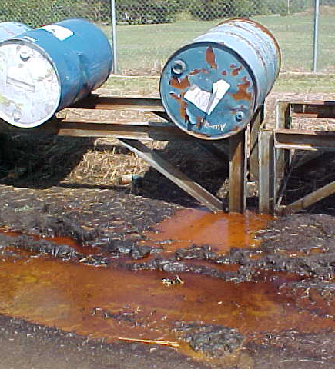
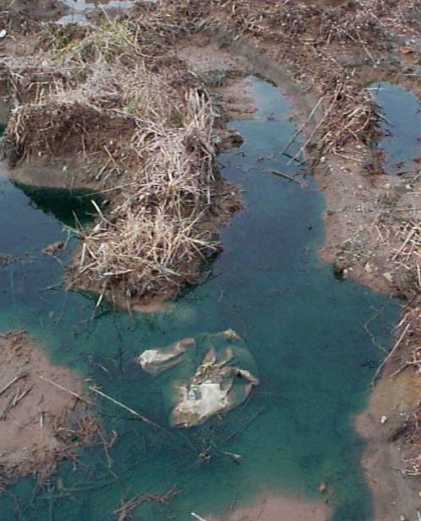
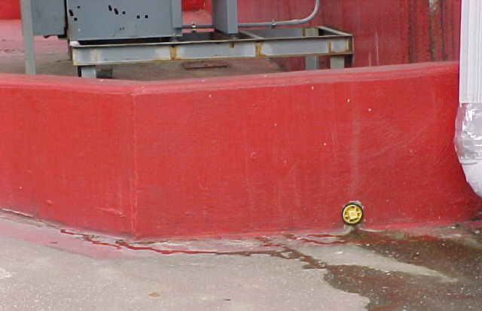
Pollutants From Local Businesses
What most people think are the greatest sources of pollution.
Industrial and Commercial Sites
Large and Small businesses

Slide 11
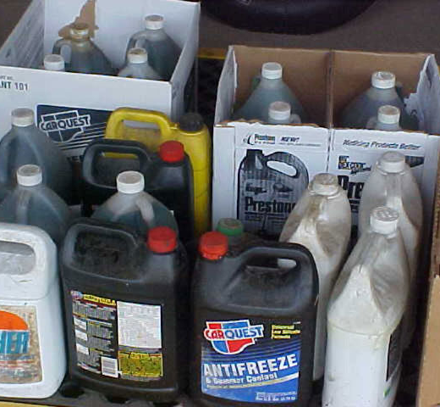
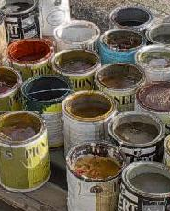
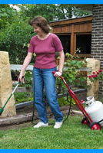
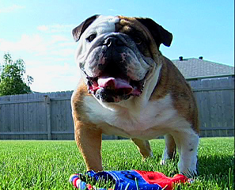
Pollutants From Homes
Toxics
Nutrients
Sediment
pH
Oils
Bacteria
Trash
Paints & Solvents
Fertilizers & Pesticides
Pet Waste (Pathogens)
Oils & Antifreeze
Yard Leaves & Grass
Swimming Pools

Slide 12
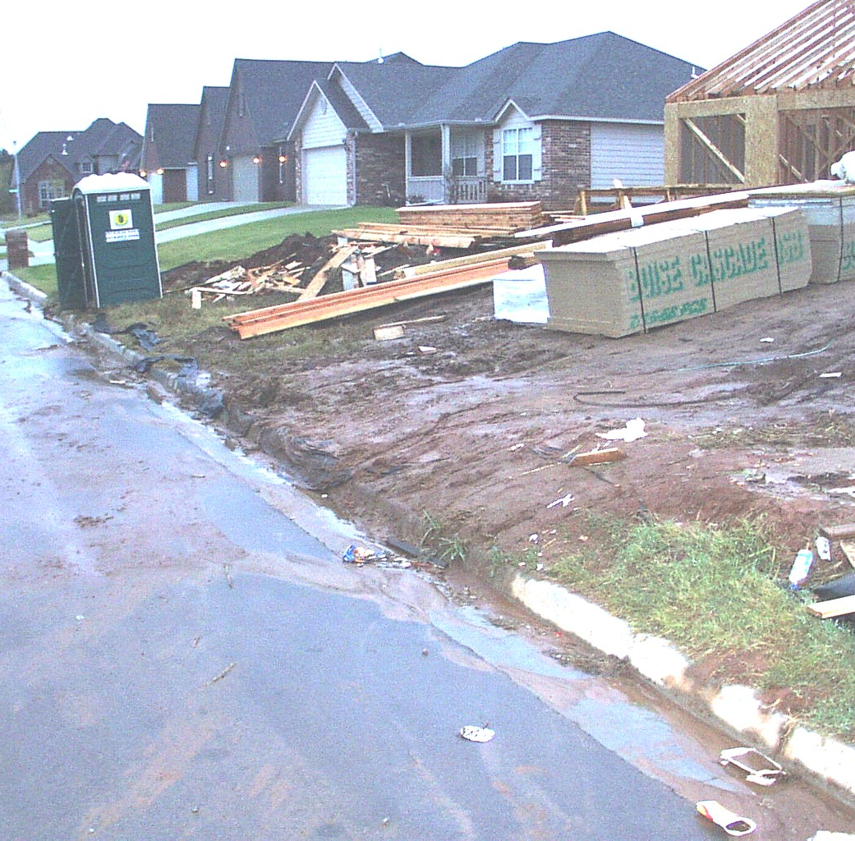
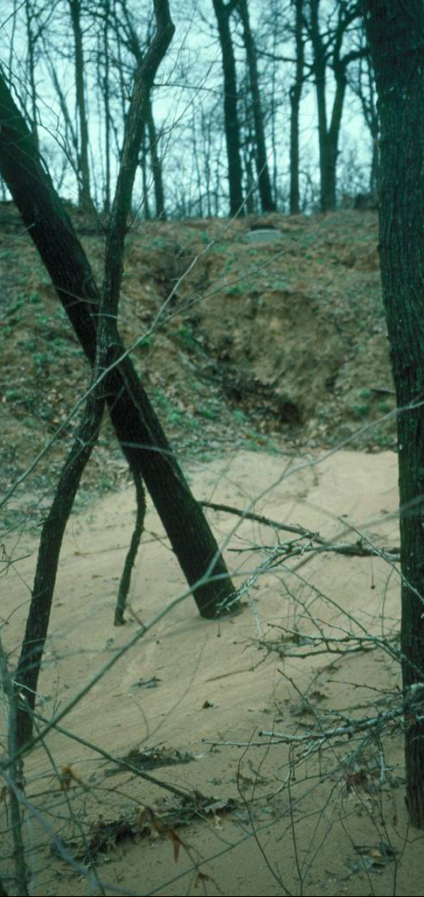
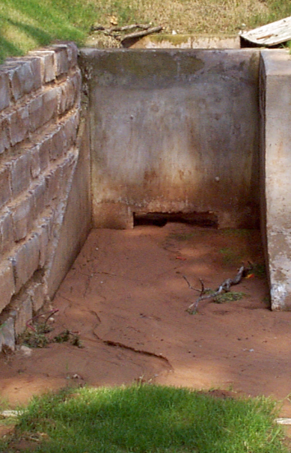
Construction Site Runoff
From Site…
To Local Creek
Sediment Clogs Stormdrains &
Harms Stream Habitat
To Stormdrain…

Slide 13
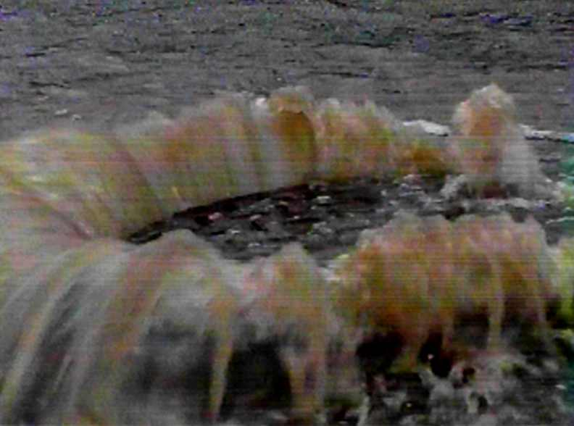
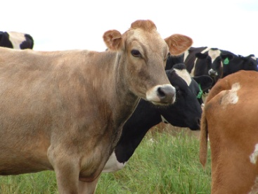
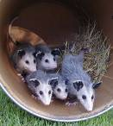
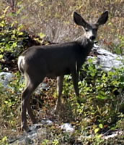
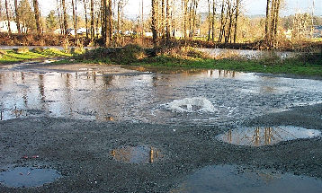
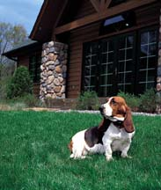
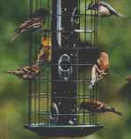
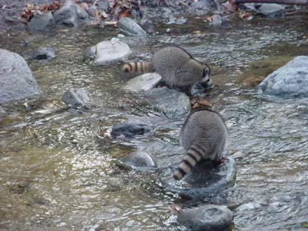
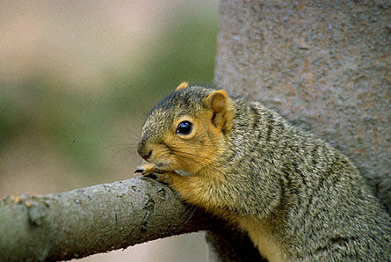
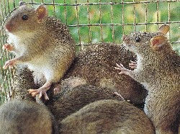
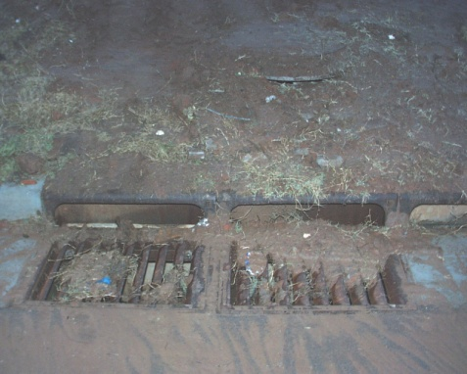

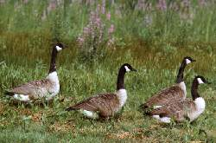
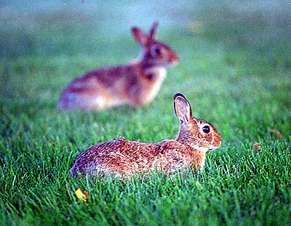
Urban / Suburban Bacteria Sources
Controllable
Partly Controllable
Uncontrollables

Slide 14
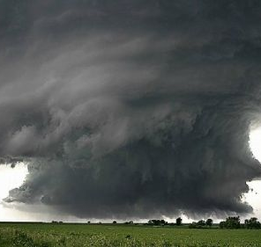
This Ends Video 1… Thanks !

